Slide 1

SMARTPHONE PURCHASE ASSISTANCE SYSTEM
by
EDIRISOORIYA GAMAGE ERANDA

Slide 2
PROBLEM STATEMENT
The Sri Lankan smartphone consumers lack the awareness of the availability of the best “bang-for-the-buck” smartphones because of,
the marketing misguidances (Huawei’s fake photo in ad)
the brand-name hypnosis (Apple’s eco-system & Smartphone market share)
the lack of knowledge about updated technology
The price of the same smartphone is varied by a huge gap among each smartphone vendor.
People need a method to identify the best value for their budget when buying a smartphone.

Slide 3
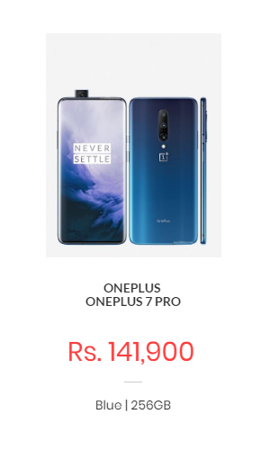
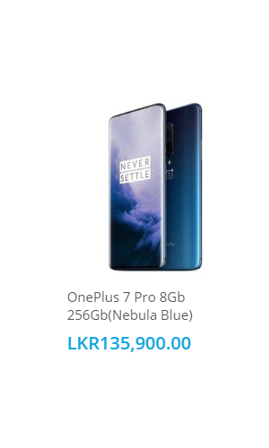
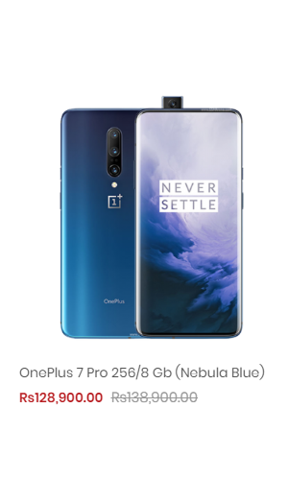
Dialcom’s Pricing (Dialcom, 2020)
Celltronics’ Pricing (Celltronics, 2020)
Techmart’s Pricing (Techmart, 2020)

Slide 4
THE REQUIREMENTS SPECIFICATION
Functional
To allow the consumer to search for a mobile phone; using smartphone price or smartphone brand or smartphone name.
To allow the consumer to identify the main aspects to look for when buying a smartphone.
To allow consumers to view details of a specific mobile phone.
To allow the consumer to view the smartphones categorized according to brand names and latest smartphones.

Slide 5
THE COMPONENT DIAGRAM

Slide 6
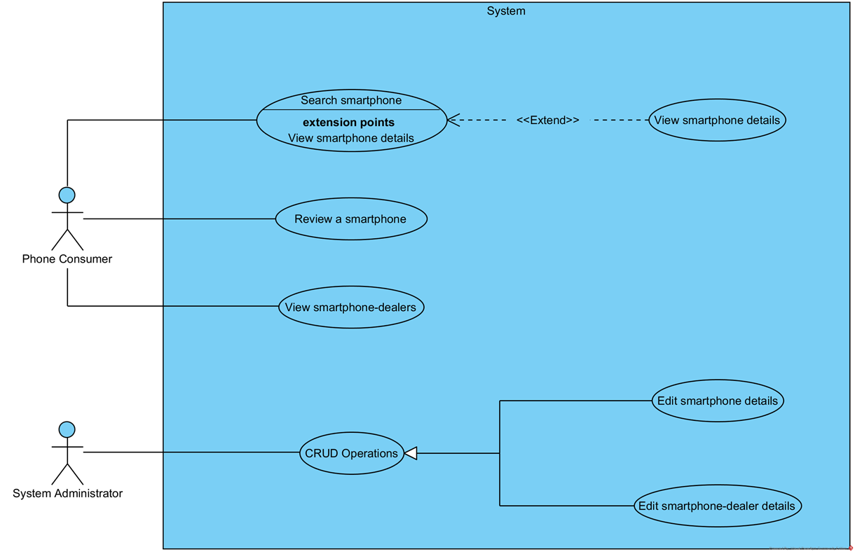
THE USE-CASE DIAGRAM

Slide 7
Thank You!

